Slide 1



ArcGIS Python API: Advanced Scripting
ROHIT SINGH rsingh@esri.com
ATMA MANI amani@esri.com

Slide 2

ArcGIS API for Python
What is it?
Pythonic representation of your GIS
Powerful, modern and easy to use
Implemented using REST + local capabilities

Slide 3
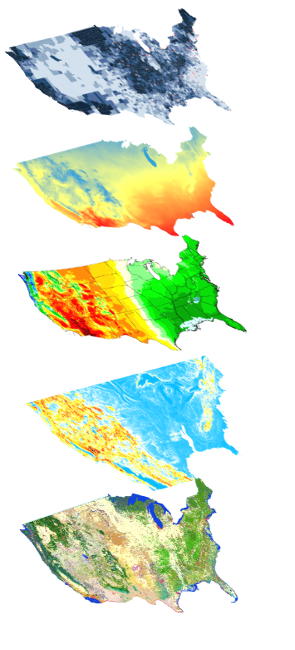
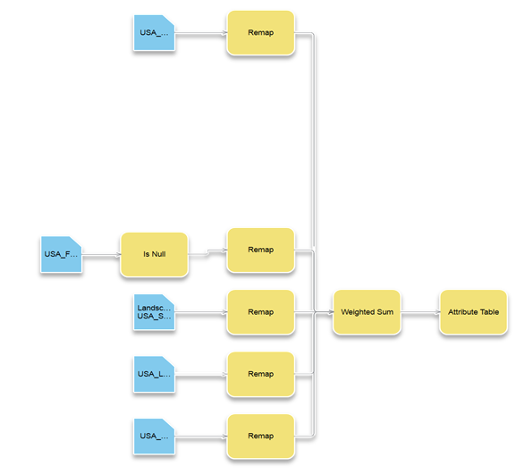
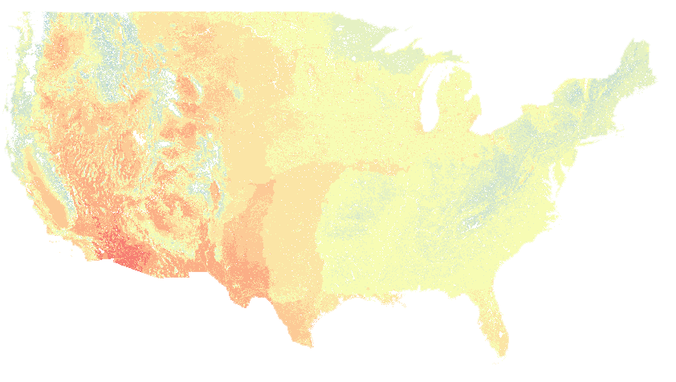

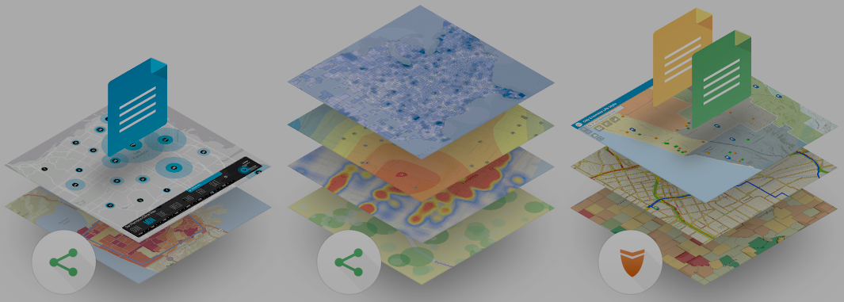
ArcGIS Python API
Big Data
Spatial Analysis
Raster Analytics
What can it do for you?
Imagery
Location Analytics
Feature Analytics
Platform API
Power Users
Developers
Analysts
Data Scientists
Enterprise Integration
Users, Roles & Group management
Administrators
DevOps
Content Publishers
Your Web GIS
Script and automate your Web GIS
Data Management

Slide 4
API Overview
geo
analytics
Pythonic GIS API
gis
geo
processing
geocoding
geometry
features
realtime
env
mapping
widgets
raster
network
schematics

Slide 5
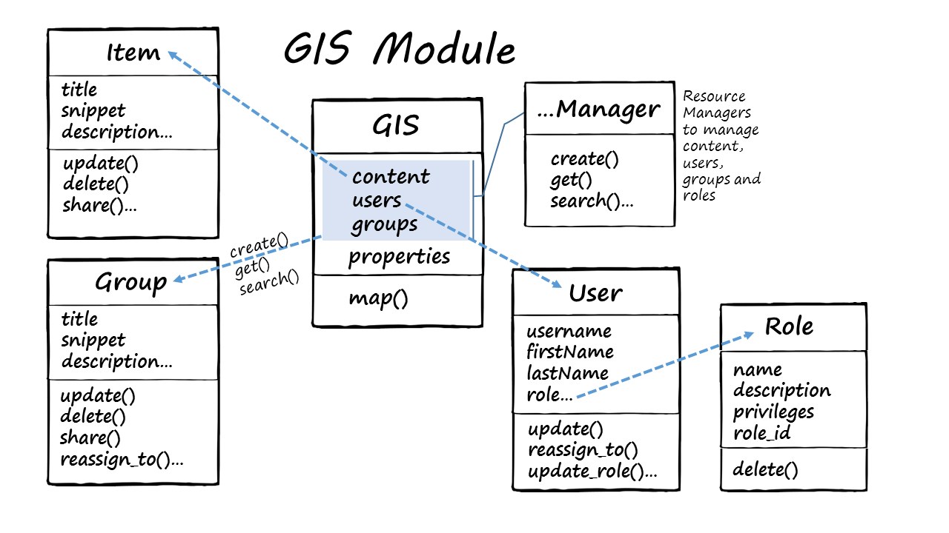
The GIS Module

Slide 6
Demo
Desktop
Apps
WebGIS Automation
GIS Module
Notes:
Quickstart
Admin
CA Fires
Hurricans and Raster

Slide 7
Demo
Desktop
Apps
WebGIS Automation
Features Module
Notes:
Quickstart
Admin
CA Fires
Hurricans and Raster

Slide 8
Demo
Desktop
Apps
WebGIS Automation
Raster Module
Notes:
Quickstart
Admin
CA Fires
Hurricans and Raster

Slide 9
Demo
Desktop
Apps
WebGIS Automation
Geocoding
Notes:
Quickstart
Admin
CA Fires
Hurricans and Raster

Slide 10
Demo
Desktop
Apps
WebGIS Automation
Geoprocessing
Notes:
Quickstart
Admin
CA Fires
Hurricans and Raster

Slide 11
Demo
Desktop
Apps
WebGIS Automation
Network Module
Notes:
Quickstart
Admin
CA Fires
Hurricans and Raster

Slide 12

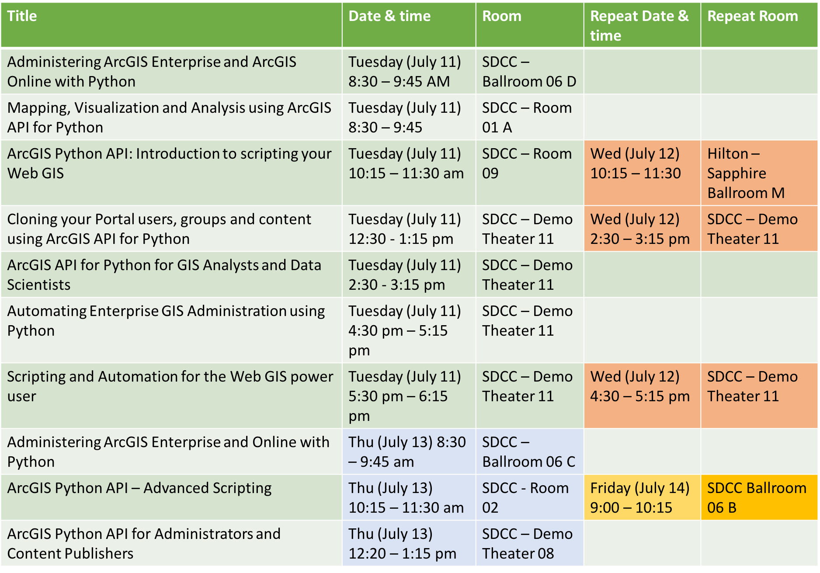


Slide 13


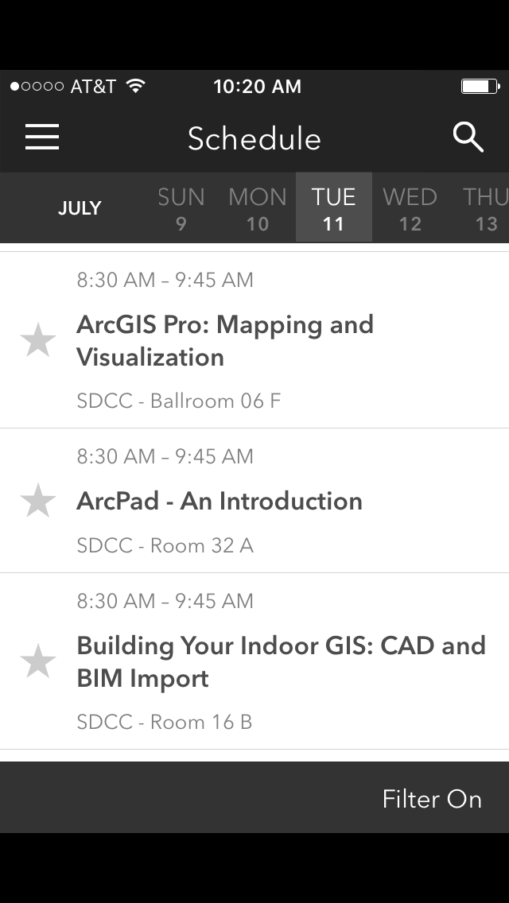
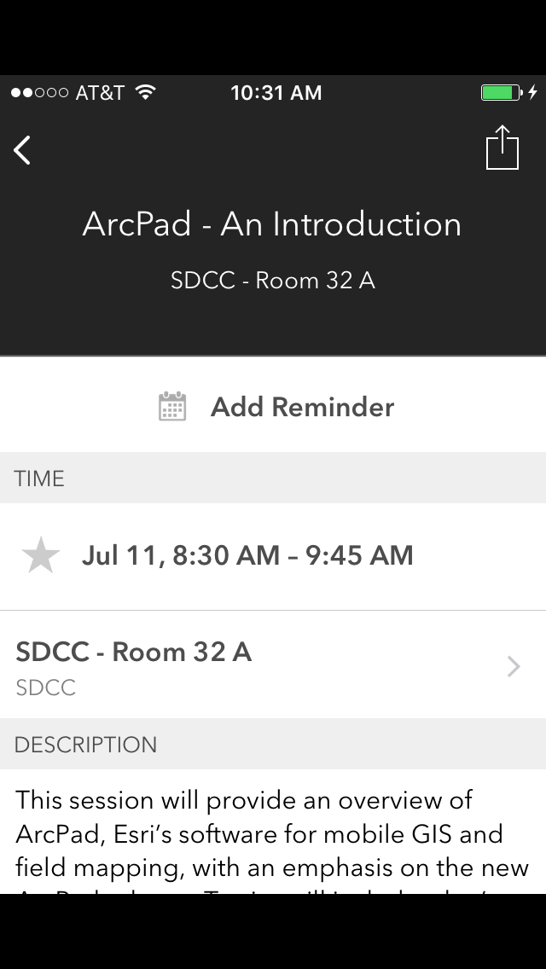
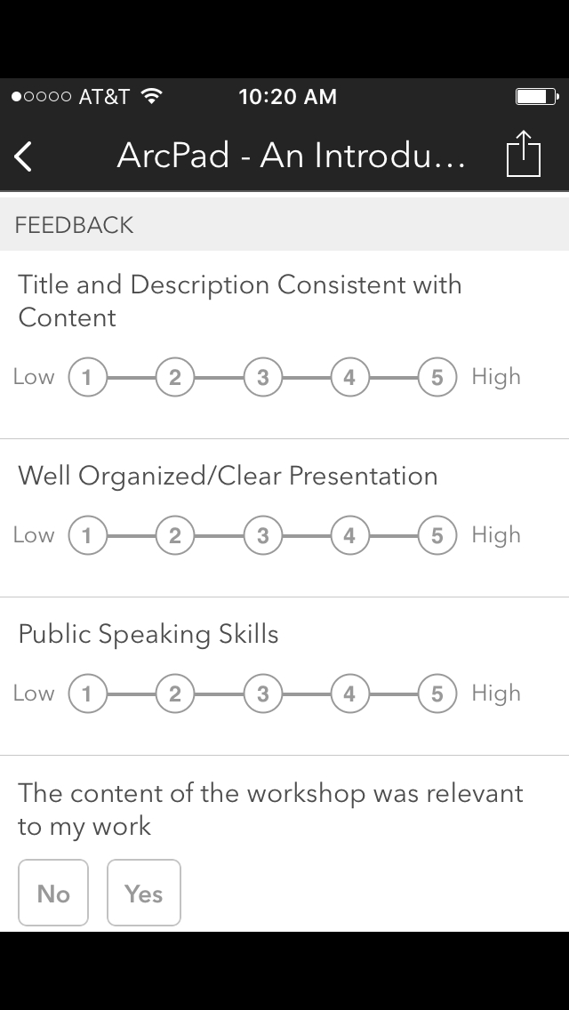
Please Take Our Survey on the Esri Events App!
Download the Esri Events app and find your event
Select the session you attended
Scroll down to find the survey
Complete Answers
and Select “Submit”

Slide 14
Questions?

